Slide 1











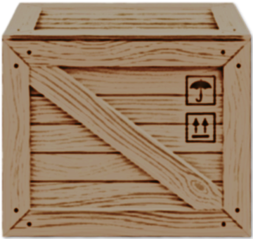


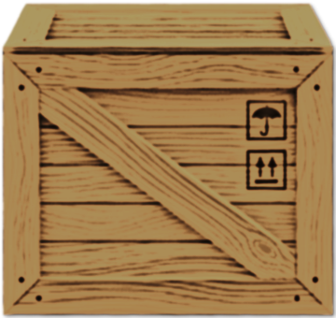



Stuck in a wooden cabin in the middle of a snowstorm, it's up to you to coordinate with your team and escape together.
Explore and interact with the house for clues;
Gather and organize information on a special board;
Help your friends by communicating with an old transceiver radio.
1st Person View; 3D Style; Single Player;
Escape Room;
For PC Only.
Alexandre Teixeira André Sebastião Daniela Peixoto Rodrigo Pires Vitor Daniel

